Slide 1
Java streams, I/O
A stream is just a continuous flow of data.
The InputStream is used to read data from a source and the OutputStream is used for writing data to a destination
The java.io package contains nearly every class you might ever need to perform input and output (I/O) in Java.

Slide 2
Byte stream and character stream
Byte stream performs input and output of 8-bit bytes.
All byte stream classes are descended from InputStream and OutputStream.
Character stream is 2 bytes stream used for character transfer.
All character stream classes are descended from Reader and Writer.

Slide 3
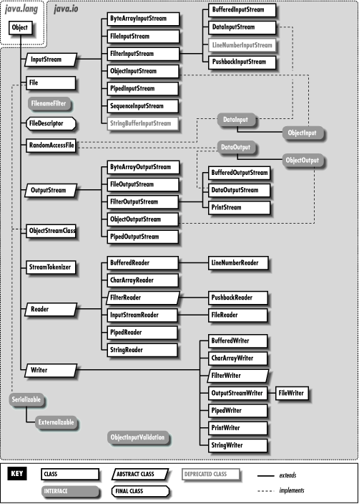

Slide 4
Byte Stream

Slide 5
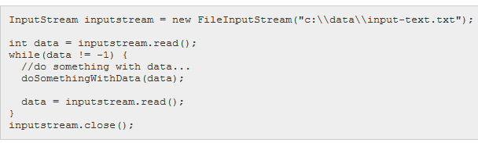
InputStream class
If the read() method returns -1, the end of stream has been reached, meaning there is no more data to read in the InputStream. That is, -1 as int value, not -1 as byte or short value. There is a difference here!

Slide 6
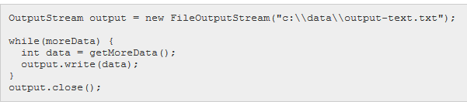
OutputStream class
Combine inputstream and output together to copy a file.
Close the stream after using.

Slide 7
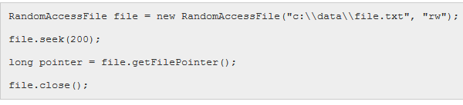
RandomAccessFile class
The RandomAccessFile class in the Java IO API allows you to move around a file and read from it or write to it as you please.
RandomAccessFile file = new RandomAccessFile("c:\\data\\file.txt", "rw");
file.read(); file.write(someBytes); file.seek(position);

Slide 8
File
The File class is part of java.io
Gives you access to the underlying file system
Use with FileInputStream/FileOutputStream/RandomAccessFile

Slide 9
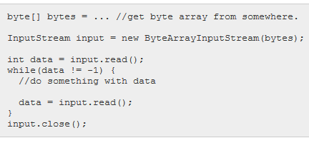
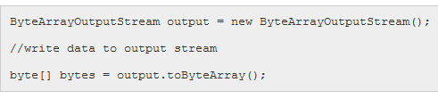
ByteArrayInputStream/ByteArrayOutputStream
Allows you to read data from byte arrays as streams and write data to an array.

Slide 10
BufferedInput/OutputStream
The BufferedInputStream class provides buffering to your input streams. Buffering can speed up IO quite a bit. Rather than read one byte at a time from the network or disk, you read a larger block at a time. This is typically much faster, especially for disk access and larger data amounts.
InputStream input = new BufferedInputStream( new FileInputStream("input-file.txt"), 8 * 1024 );
OutputStream output = new BufferedOutputStream( new FileOutputStream("output-file.txt"), 8 * 1024 );

Slide 11
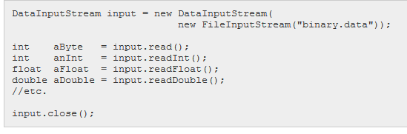
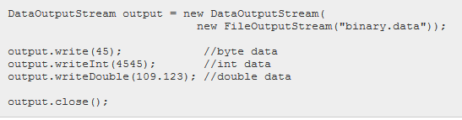
DataInput/OutputStream
Let the class to read/write primitive types instead of bytes only.

Slide 12
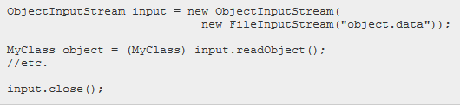
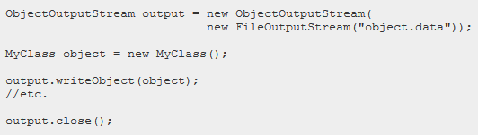
ObjectInputStream/OutputStream
Enables user to read/write Java objects instead of only bytes.

Slide 13
Character Stream

Slide 15
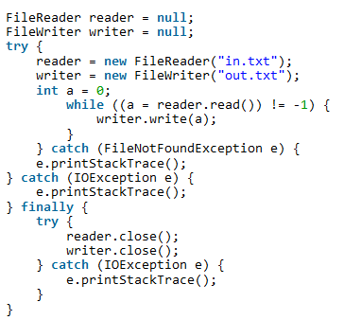
The character streams are capable to read 16-bit characters (byte streams read 8-bit characters)

Slide 16
Serialization

Slide 17
To serialize an object means to convert its state to a byte stream so that the byte stream can be reverted back into a copy of the object.
public class Person implements Serializable {
private static final long serialVersionUID = 8178095700287115233L;
}
java.io.Serializable is a marker interface. Nothing is defined inside it.
serialVersionUID is the identifier of the class. The same class should have the same uid.

Slide 18
Object inside another serializable object must be serializable too.
If parent class is serializable, then child class is automatically serializable.

Slide 19
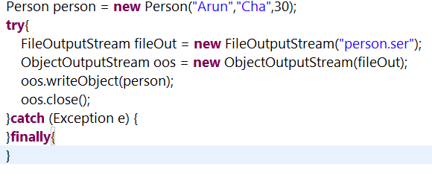
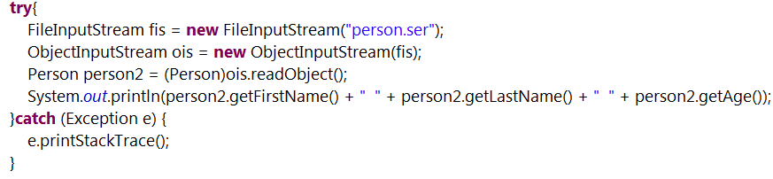
Use ObjectOutputStream/ObjectInputStream to write/read object from other sources, like a file.

Slide 20
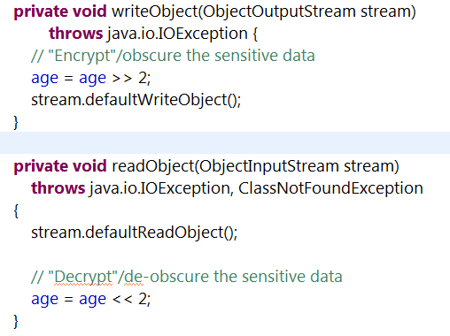
Serialization allows class refactoring.
Serialization is not safe.
writeObject
readObject

Slide 21
“transient” keyword prevent serialization.
“static” field won’t be serialized too.

